Slide 1
Networking with Wireshark
Networks 101 Day 2

Slide 2
Today’s Objectives
By the end of class, you will be able to:
Describe the flow of typical HTTP conversations at the application layer.
Describe the flow of DNS conversations at the application layer.
Describe the flow of typical TCP conversations.

Slide 3
Activity: Leaky HTTP Traffic
In this partner activity, you’ll use Wireshark to retrieve a user’s username and password being communicated through an insecure website.
Instruction sent via Slack.
8 Minutes

Slide 4
Leaky HTTP Traffic

Slide 5
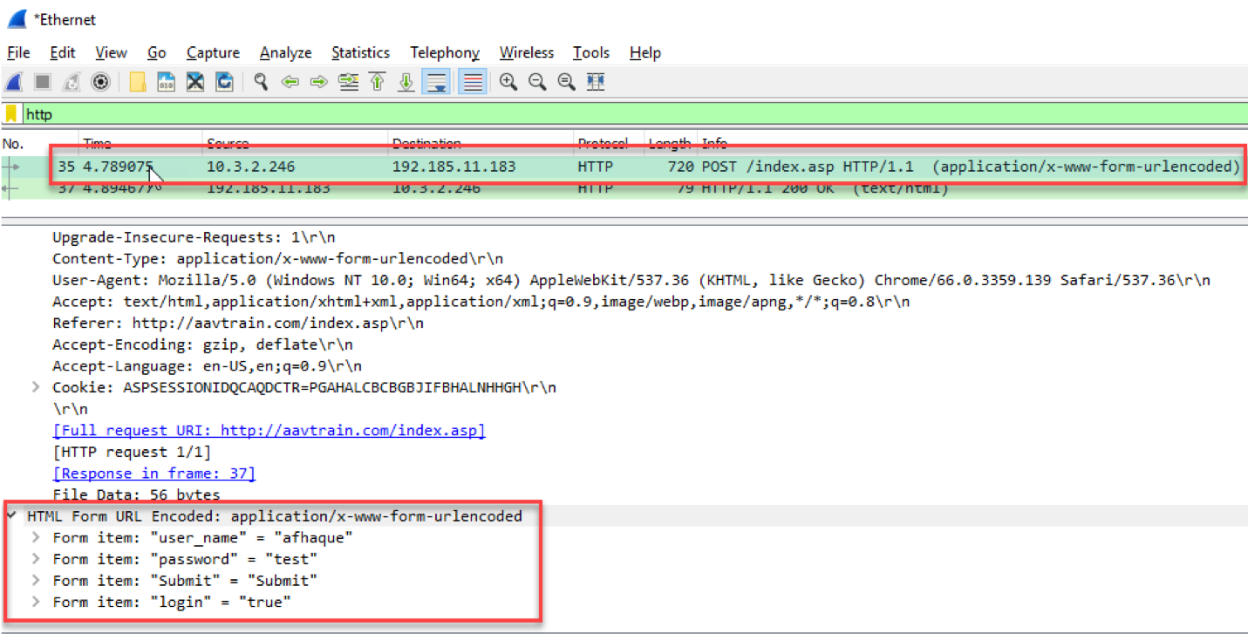

Slide 6
HTTP

Slide 7



HTTP: Hypertext Transfer Protocol
HTTP is an application-layer protocol designed primarily for communication between web browsers and web servers, and uses typical client/server architecture.
POST /userHTTP/1.1
...
{
“Name”: “Aladdin”,
“Age”: 18
}
GET /cat.jpg HTTP/1.1
HTTP Request message
HTTP Request message
“I’d like cat.jpg please”
Please create a user with the following data:
{
“Name”: “Aladdin”,
“Age”: 18
}
HTTP Response message:
“OK. Here’s the file you asked for:”
HTTP Request message:
“We created it”

Slide 8
HTTP Request
method
Sp
URL
Sp
Version
Cr
If
Request line
Header field name
:
value
Cr
If
:
Header Line
Header field name
:
value
Cr
If
Cr
If
Example HTTP Request:
GET /hello.txt HTTP/1.1
User-Agent: curl/7.16.3 libcurl/7.16.3 OpenSSL/0.9.7l zlib/1.2.3
Host: www.example.com
Accept-Language: en, mi
Entity Body

Slide 9
HTTP Status Codes
Type | Status Codes | Examples
Informational | 1xx | 100: Continue, 101: Switching Protocol
Success | 2xx | 200: OK, 201: Created, 202: Accepted
Redirection | 3xx | 300: Multiple Choices, 301: Moved Permanently, 302: Found
Client Error | 4xx | 400: Bad Request, 403: Forbidden, 404: Not Found, 422: Unprocessable Entity
Server Error | 5xx | 500: Internal Server Error, 503: Service Unavailable
Notes:
Source: https://www.seleniumeasy.com/selenium-tutorials/how-to-find-broken-links-using-webdriver-java

Slide 10

HTTP vs HTTPS
HTTPs (HTTP Secure) uses an SSL certificate (TLS) to encrypt data before sending, and decrypt upon arrival.
Notes:
Https shutterstock ID 1015953835

Slide 11
HTTP Demo

Slide 12
Activity: Analyzing HTTP
In this activity, you will look at HTTP conversations to reverse-engineer the HTTP protocol.
Instructions sent via Slack.
20 Minutes

Slide 13
Analyzing HTTP

Slide 14
Activity: The Search for Something Cool
In this activity, you will open a previously captured file and then tasked with importing a pcap file and using display filters to retrace a user's browsing history.
Instructions sent via Slack.
20 Minutes

Slide 15
The Search for Something Cool

Slide 16
Today’s Objectives Checkout
By the end of class, you will be able to:
Describe the flow of typical HTTP conversations at the application layer.
Describe the flow of DNS conversations at the application layer.
Describe the flow of typical TCP conversations.

Slide 17
DNS
Domain Name System (DNS) is an application-layer protocol designed to translate domain names into IP addresses.
DNS Server
“Google.com please?”
Application
Data
Presentation
Data
Session
Data
172.217.11.174
Transport
Segments
Network
Packets
Data Link
Frames
Physical
Bits

Slide 18
Domain Names
nslookup is a command line tool used for manual DNS resolution.
$ nslookip google.com
Server: RAC2V1S
Address: 192.168.1.1
Non-authoritative answer:
Name: google.com
Addresses: 2607:f8b0:4004:800:200e
172.217.15.110

Slide 19
DNS Record Types
DNs allows you to query for more than just domain → IP Address. Record types:
A record: IPv4 address from a hostname query
AAAA record: IPv6 address from a hostname query
MX record: mail server for the domain
CNAME: alias to the domain name
NS record: nameserver of the domain
PTR record: hostname from an IP address

Slide 20
DNS in Wireshark

Slide 21
Activity: Wireshark DNs Analysis
In this activity, you will look at pcap files and identify DNS traffic.
Instructions sent via Slack.
10 Minutes

Slide 22
Your Turn: Analyzing DNS in Wireshark
Instructions:
Open the dns-1.pcap file.
This file only contains DNS replies. How many DNS requests were there?
When the user asked for assets.espn.go.com, what happened?
What is/are the IP address(es) for a1.espncdn.com?
Open the dns-2.pcap file.
This capture contains an attempted query, but something went wrong.
What happened?
Which flag in the packet reveals what went wrong?
The request went to 8.8.8.8. Did the response come directly from 8.8.8.8?

Slide 23
Analyzing DNS in Wireshark

Slide 24
Transport Layer Protocol

Slide 25
Transport Layer Protocol
Transport Layer is responsible for end-to-end communication over a network and sending data to the appropriate application.
Works with session layer to manage connection between application on different machines.
Two most common protocols of transport is UDP and TCP
Data
Application
Data
Presentation
Data
Session
Segments
Transport
Packets
Network
Frames
Data Link
Bits
Physical

Slide 26
UDP
UDP is stateless or "connectionless," and it's used when we don't care whether we get all of our data. It is also typically faster
UDP Request / Response Paradigm:
Request
Response

Slide 27
TCP
TCP is used when all transmitted data must be received. Used with familiar protocols such as HTTP, FTP, SSH, and SMTP.
TCP Handshake Paradigm:
Open Connection:
Handshake
Request
Response

Slide 28
TCP Headers and Flags
32 Bits
Source Port
Destination port
Sequence number
Acknowledgement number
TCP header length
CRW
ECE
URG
ACK
PSH
RS
T
S Y
N
F
I
N
Window Size
Checksum
Urgent pointer
Options (0 or more 32-bit words)
Data (optional)

Slide 29
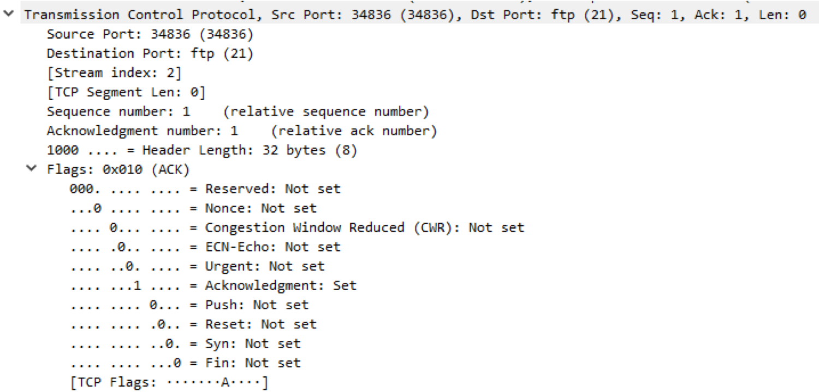
TCP Headers and Flags
Flags in TCP Headers

Slide 30
TCP Headers and Flags
Flags to indicate what kind of TCP message is contained within:
SYN – Synchronization: first step in establishing handshake between hosts
ACK – Acknowledgement: used to acknowledge successful receipt of a packet
PSH – Push: tell recipient to process this packet as it is received, don’t buffer it
RST – Reset: sent when a packet was sent that was unexpected
FIN – Synchronization: first step in establishing handshake between hosts

Slide 31
TCP Handshake
Connection-Oriented, 3-way handshake, 4-way close
Setup: SYN, SYN-ACK, ACK
Teardown: FIN, ACK, FIN, ACK
FIN
SYN
ACK
SYN-ACK
FIN
ACK
ACK
Data

Slide 32
TCP Handshake
SYN
0 ms
28 ms
SYN ACK
ACK
56 ms
GET /file
84 ms
4x TCP segments
5840 bytes
124 ms
4x ACK
152 ms
8x TCP segments
11680 bytes
180 ms
8x ACK
208 ms
3x TCP segments
43800 bytes
236 ms
3x ACK
264 ms

Slide 33
TCP vs UDP Comparison Example
Scenario: you want your friend’s toy.
TCP:
You call your friend’s phone number.
He picks up and says, “Howdy, Buzz!”
You say “Hey, Woody!”
You ask for the toy.
He sends you the toy
UDP:
You call and leave a voicemail saying you want his toy.
The toy may arrive in the mail.
3 - Way Handshake

Slide 34
Activity: Explain / Draw the Process
In this activity, you will practice explaining the basics of what happens in layers 4-7 of the OSI Model and then draw the process of request/response for an HTTP page through the network.
Instructions sent via Slack.
10 Minutes

Slide 35
Your Turn: Analyzing DNS in Wireshark
Instructions:
Draw the process of request/response for an HTTP page through the network in the context of the OSI model, labelling:
The protocol(s) used at each layer
How the protocol works at that stage of the process
The format of the data at that point in the layer
When confident in your drawing, compare with your partner’s drawing.
Try to explain your diagram, and note any differences between the two.
Act out the TCP communication and handshake process with your partner.
Bonus: Do the same for DNS.

Slide 36
Explaining and Drawing the Process

Slide 37
Activity: Digging Into TCP Communication
In this activity, students will observe a pcap with TCP communication and answer a few questions about the file.
Instructions sent via Slack.
15 Minutes

Slide 38
Your Turn: Digging Into TCP Communications
Instructions:
Open the tcp.pcapng file with Wireshark
Filter for TCP packets only.
Find all TCP SYN packets.
Find all TCP FIN packets.
Filter for a single TCP stream using the "FTP" protocol.
Find the 3-way handshake sequence.
Find the TCP teardown sequence.
What are the source/destination IP addresses and ports?

Slide 39
Digging into TCP Communications

Slide 40
Today’s Objectives
By the end of class, you will be able to:
Describe the flow of typical HTTP conversations at the application layer.
Describe the flow of DNS conversations at the application layer.
Describe the flow of typical TCP conversations.

